Slide 1
Book Retailer Sales of Over
2 Decades
By: Emilio Avalos, Jaime Fastino, Nicole Heidi Romangsuriat

Slide 2
Agenda
01.
03.
Introduction to Problem
Models Investigated + Analysis
02.
04.
Time Series Plot & GG Seasonal Plot
Accuracies & Recommendation
>
<
>
<

Slide 3
Introduction to Problem

Slide 4


Bookstore Retail Sales
Recent discussion about e-book platforms -> Interest in investigating effects on bookstore sales
Original Hypothesis: The emergence of bookstore alternatives such as e-book platforms (eg. Kindle and Wattpad) and digital comic platforms (eg. Webtoon) have caused brick-and-mortar bookstore sales to dwindle

Slide 5
Considered Factors Influencing Book Retail Industry Sales
01.
Education Rates
02.
Literacy Rates
03.
E-Book Industry
04.
“Book Thrifting”

Slide 6

Dataset
U.S. Census Bureau
“Retail Food and Services Sales 1992-2022” dataset
Compiled monthly book retailer sales into a dataset
372 data values
Notes:
The U.S. Census Bureau had collected this data from the Monthly Retail Trade Survey, Annual Retail Trade Survey, Service Annual Survey, and national administrative records

Slide 7
Time Series Plot

Slide 8
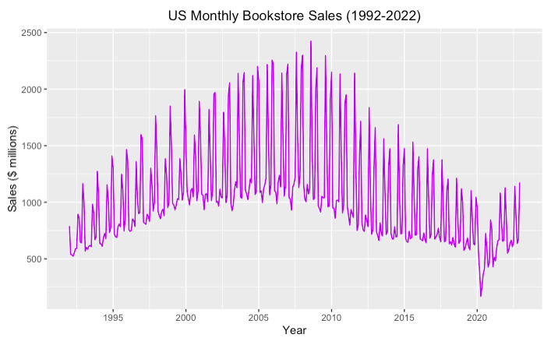
Qualitative Analysis
Non-constant trend
⬆⬇⬆
Non-constant annual seasonality!
Outlier: 2020, COVID

Slide 9
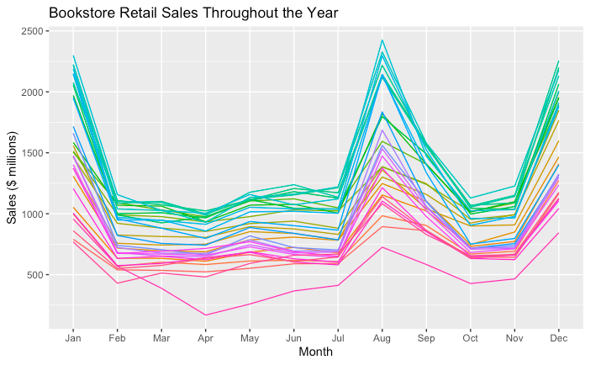
Annual Seasonality
**January: back-to-school (spring)
**August: back-to-school (fall)
**December: Christmas shopping

Slide 10
Models Investigated + Analysis

Slide 11
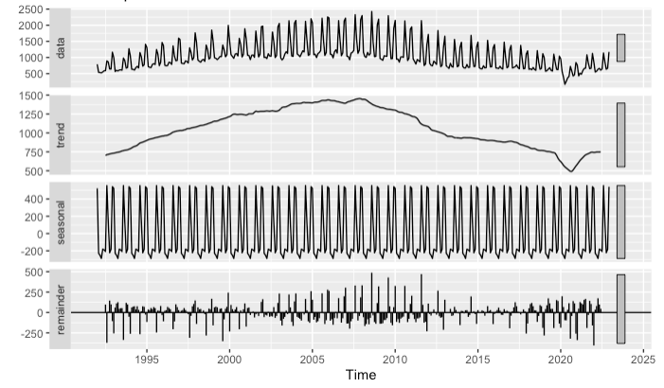
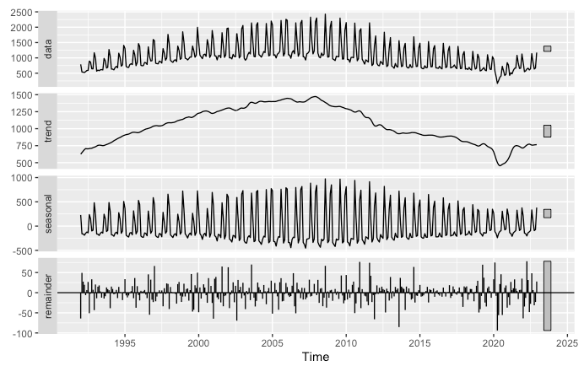
Decomposition
Classical
Wave-pattern in remainder
STL
Models non-constant
seasonality better

Slide 12

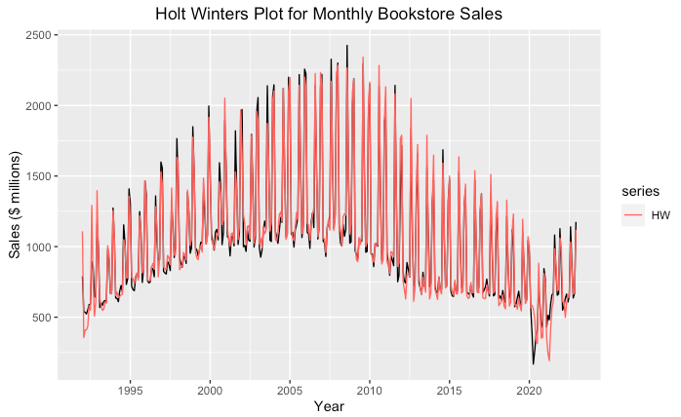
Holt Winters
Some smoothing of level
Little smoothing of trend
Significant smoothing of seasonality
Good model fit!

Slide 13
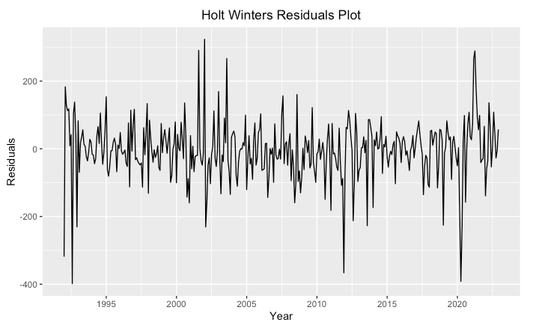
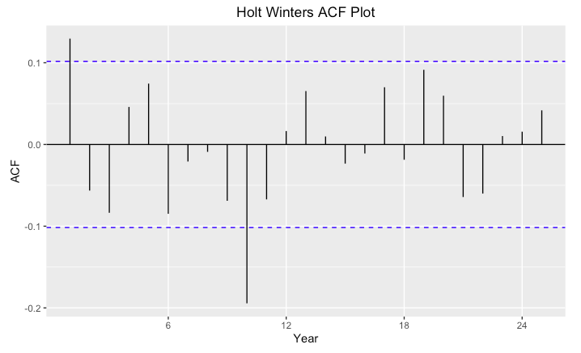
Holt Winters Residuals
White noise
2 autocorrelations
Lag 1, Lag 10

Slide 14
SARIMA Family of Models
1) Follows auto.arima recommendation of ARIMA(1,1,1)(0,1,1)[12]
All terms statistically significant given the 95% confidence interval
Residuals fairly stationary and minimal autocorrelation
RMSE of 80.78
2) Increased seasonal autoregressive term with ARIMA(1,1,1)(1,1,1)[12]
Extra seasonal autoregressive term was insignificant
Residuals and autocorrelation similar to the first SARIMA model
RMSE of 80.58, seasonal AR insignificant
⬆⬆⬆ Chosen Model

Slide 15
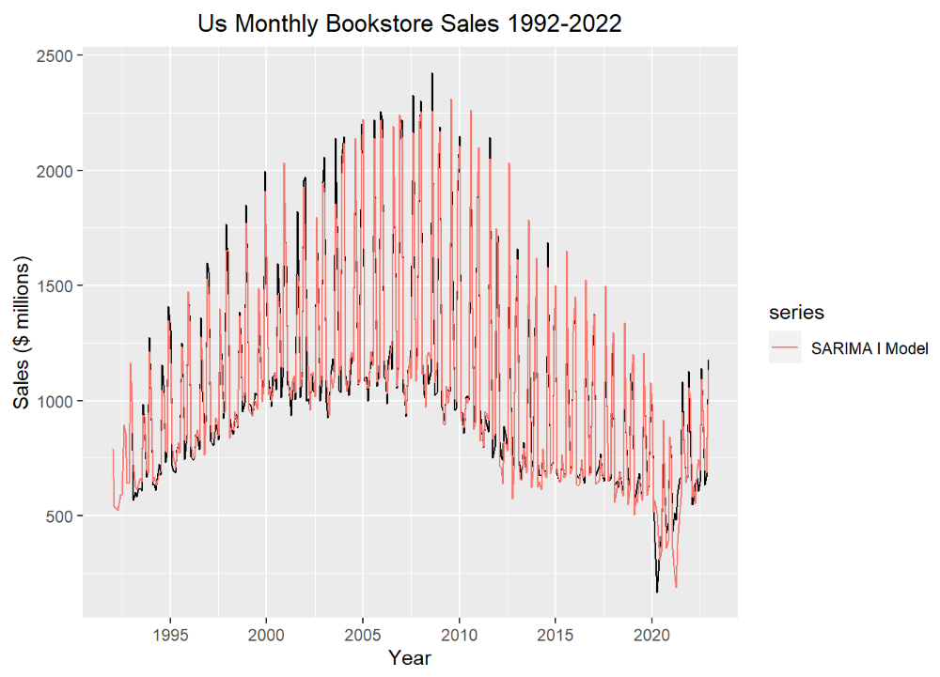
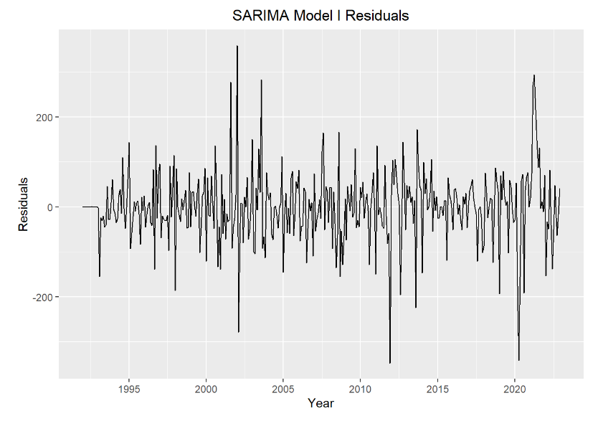
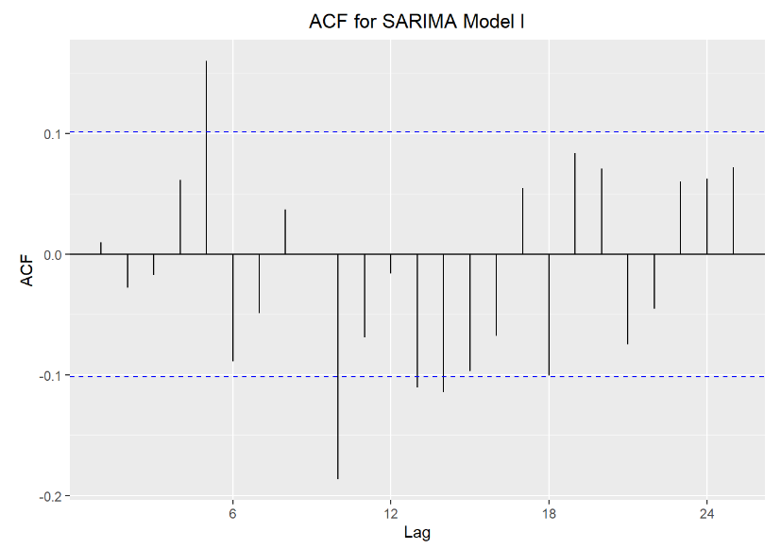
SARIMA FAMILY

Slide 16
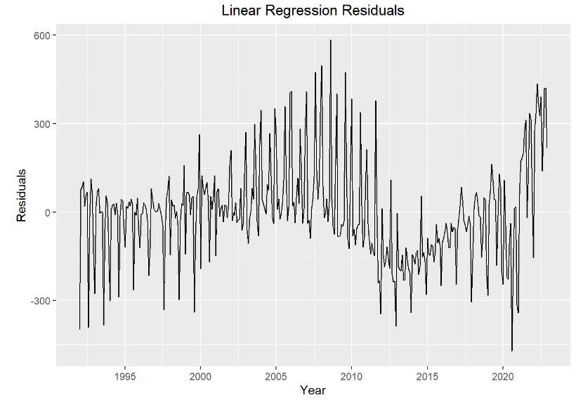
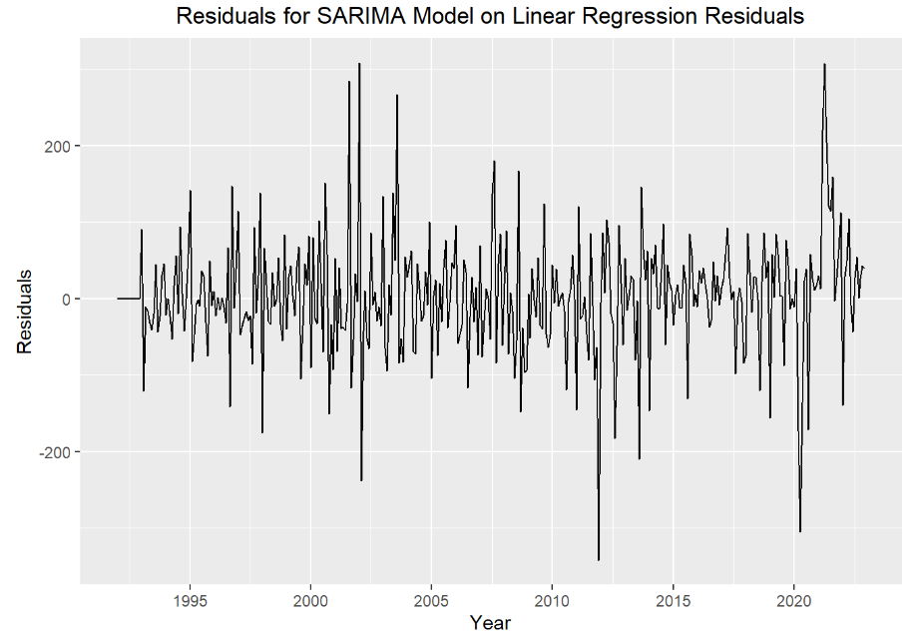
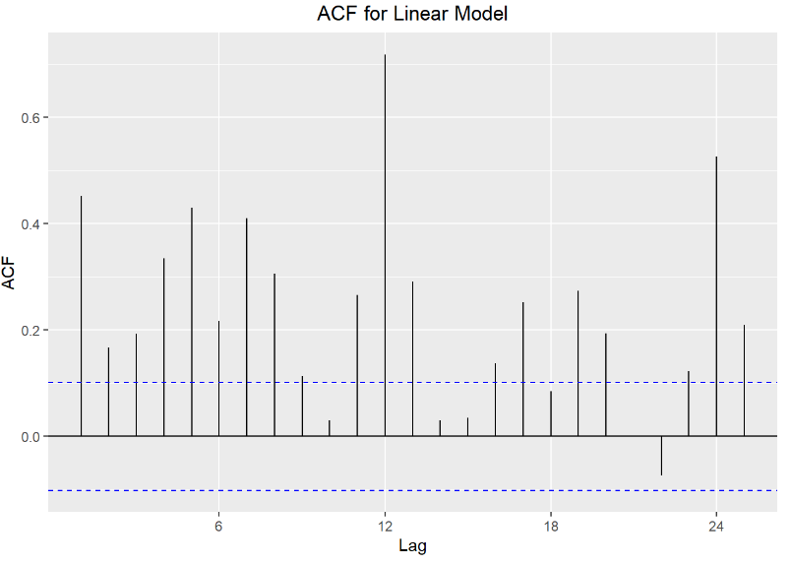
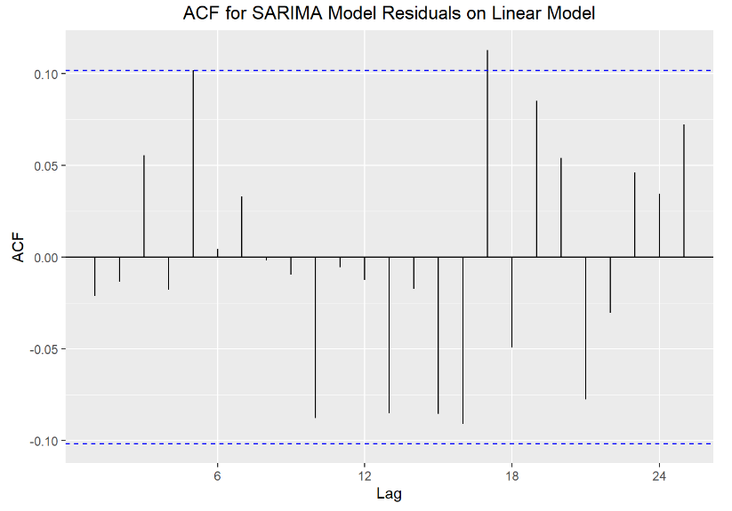
Linear Regression
Pre-Corrections
Post-Corrections
All variables significant except for August & December
ARIMA (3,0,3)(0,1,1)[12] on Residuals
Improved RMSE

Slide 17
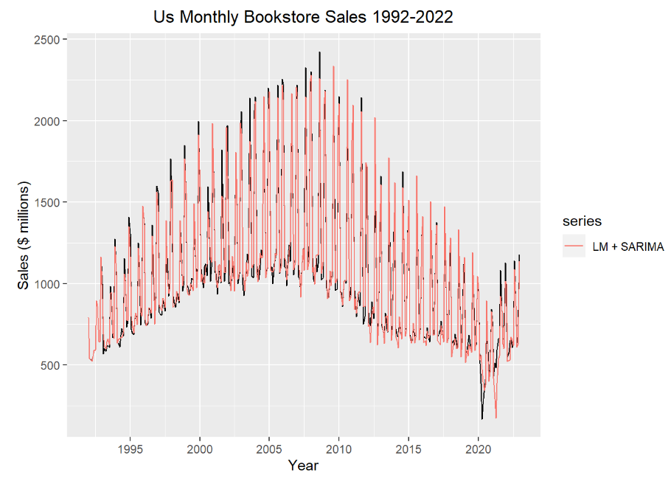
Linear Regression with SARIMA
All variables significant; except for August and December dummy variables
Improved RMSE from 165.88 to 76.65, an improvement of 53.79%
Multiple R-Squared: 85.43%

Slide 18
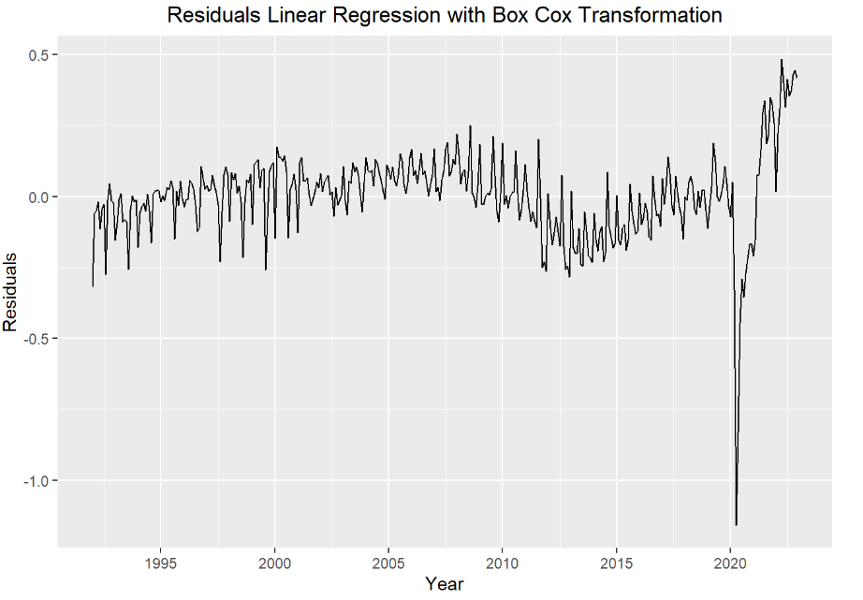
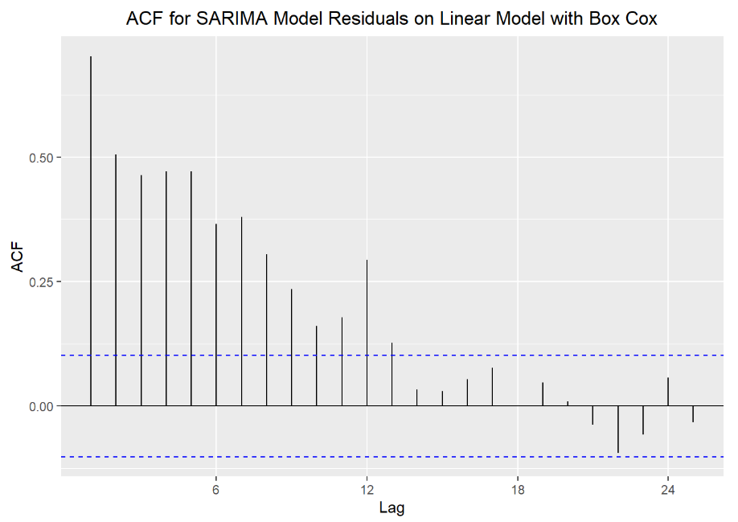
Linear Regression with Box Cox Transformation
All variables significant; except for August and December dummy variables
Box Cox transformation did not improve the linear model that much – will need to conduct a ARIMA(1,0,2)(1,0,2)[12] on the residuals

Slide 19
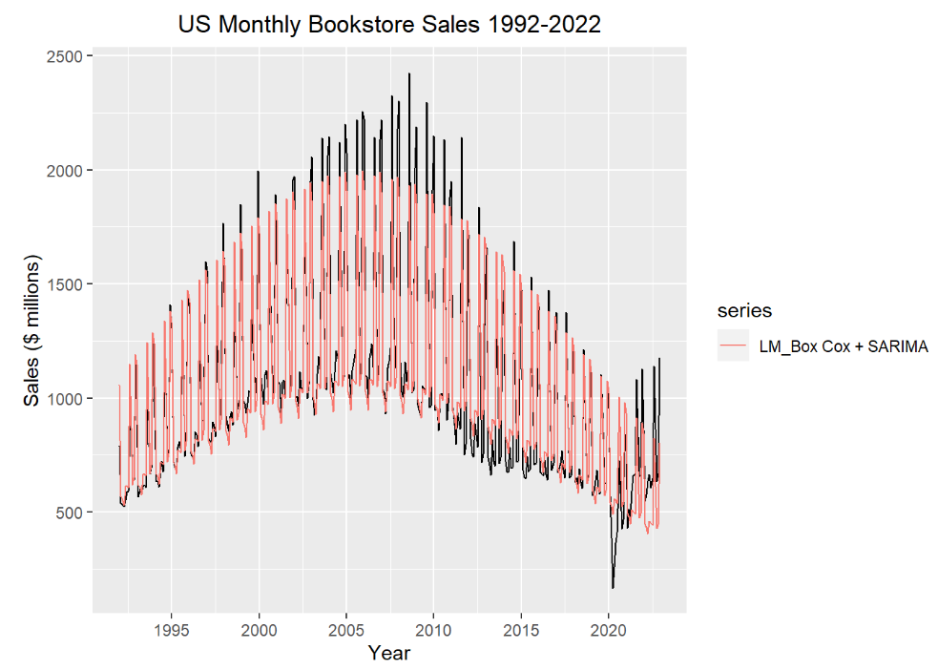
Linear Regression with Box Cox & SARIMA
After applying SARIMA model on residuals:
RMSE of 127.89
Multiple R-Squared: 87.35%

Slide 20
Accuracies & Recommendation

Slide 21
Comparison of RMSE Values
Model | S.Naive | Holt-Winters | ARIMA | SARIMA | Linear Regression
 |  |  |  |  | Normal | + SARIMA on Residuals | + Box Cox & SARIMA on Residuals
RMSE Value | 437.41 | 87.71564 | 80.78441 | 80.58239 | 165.8814 | 76.65521 | 127.8861
7th
4th
3rd
2nd
6th
1st
5th

Slide 22

Recommended Model
Linear Regression with SARIMA on Residuals
Lowest RMSE value -> most accurate
Best Model Fit
Best for in-sample predictions / forecasting

Slide 23
Thank You!
Questions are welcome.

